Slide 1
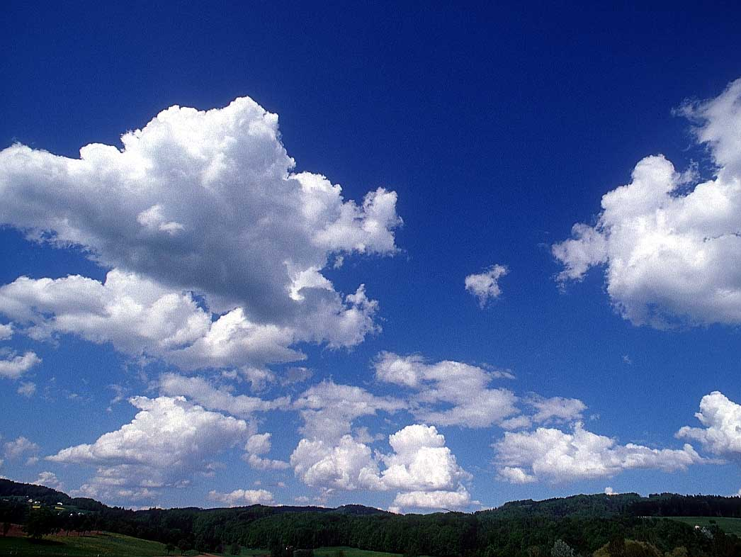
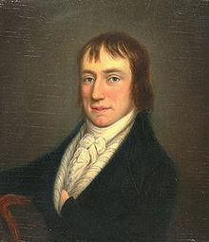
William Wordsworth
Poems
As We See It

Slide 2
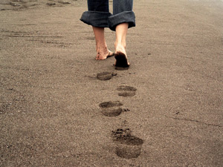
We wandered lonely and lost through this little SLO town

Slide 3
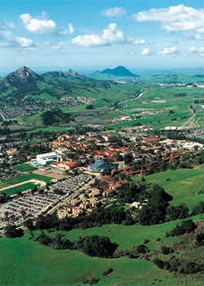
Fresh out of high school into college we came with a bound

Slide 4
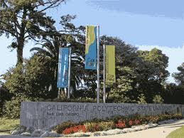
Not sure where to go on the first day of school

Slide 5
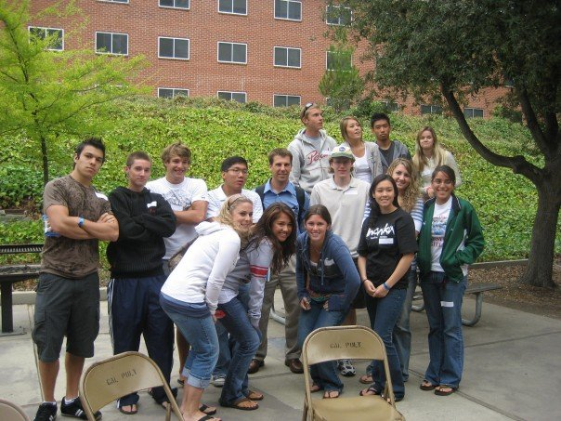
Where the heck is my class, the gym and the pool

Slide 6
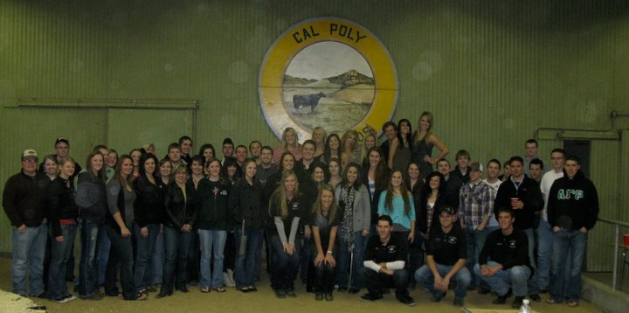
We searched and searched for somewhere to belong

Slide 7
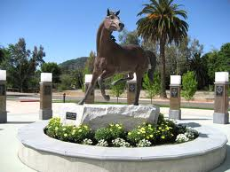
But we made it to Cal Poly, which is where we all belong

Slide 8
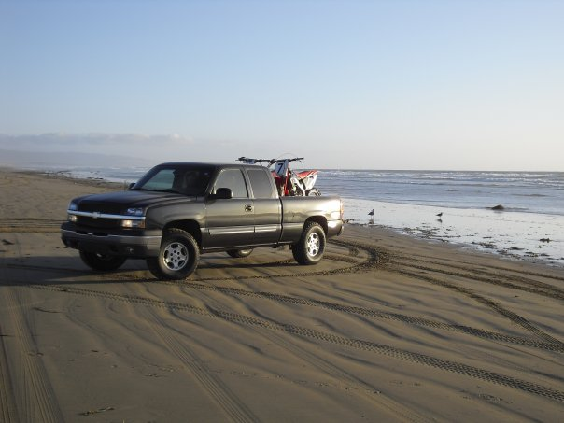
When life gets tuff and knocks us off our feet

Slide 9
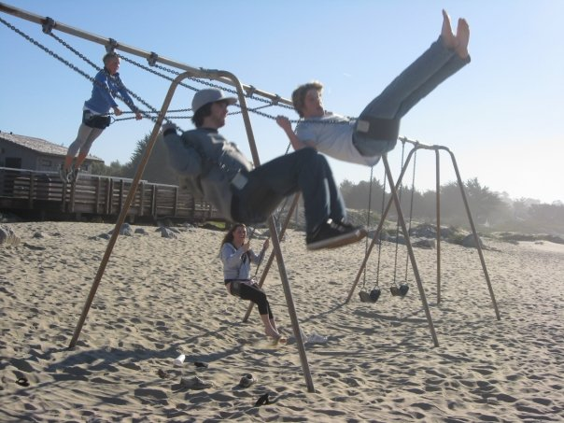
We pack up our stuff and head to the beach

Slide 10
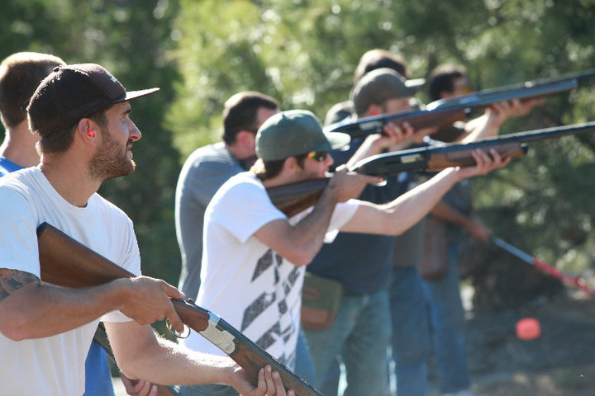
We were all scared all shaking with fear

Slide 11
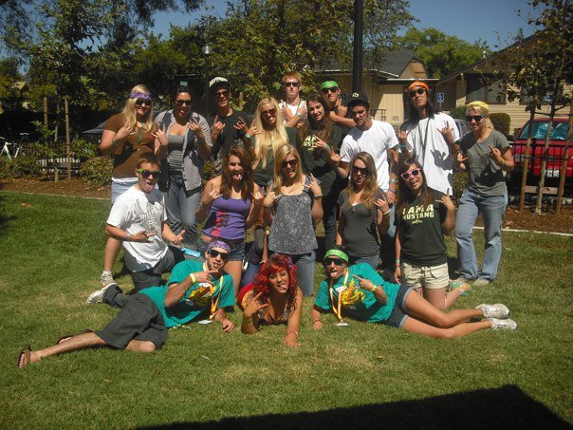
Until quickly enough two Wow leaders appeared

Slide 12
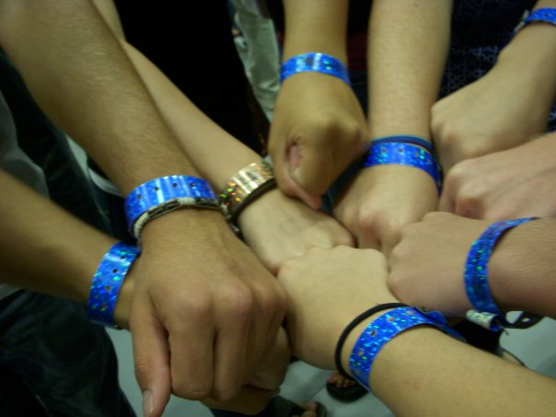
They were all happy and jumping in laughter

Slide 13
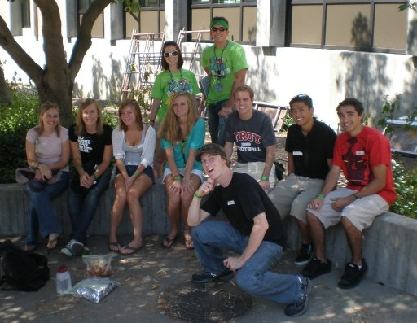
Little did we know the week would soon be an after

Slide 14
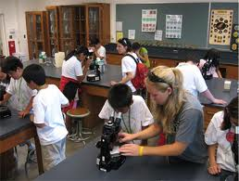
Into our classrooms we fled

Slide 15
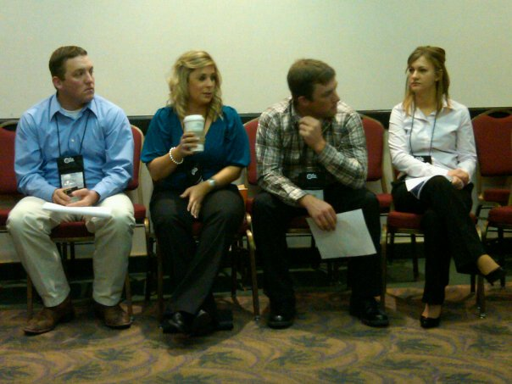
With four years for classes and tests to dread

Slide 16
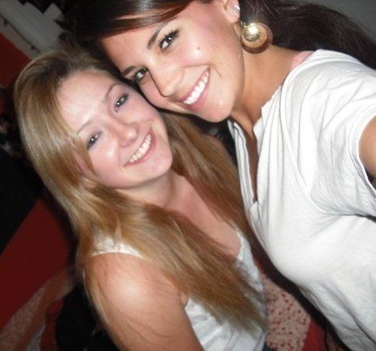
We lived in the dorms and ate terrible food

Slide 17
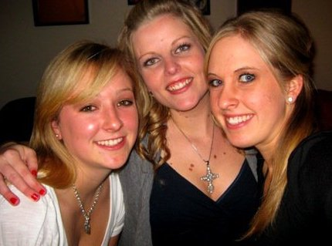
And we made friends that helped us feel better when we’re in a bad mood

Slide 18
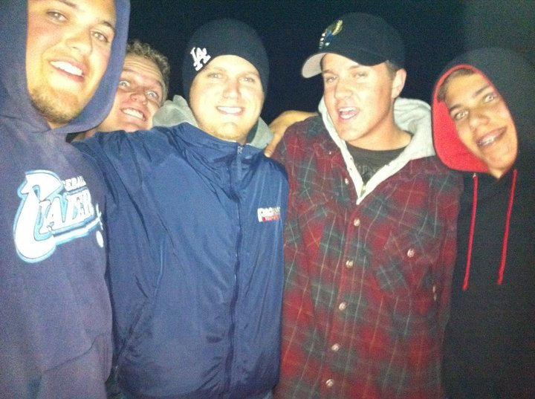
friends that will be with us till the end

Slide 19

They’ll even be there on the day we wed

Slide 20
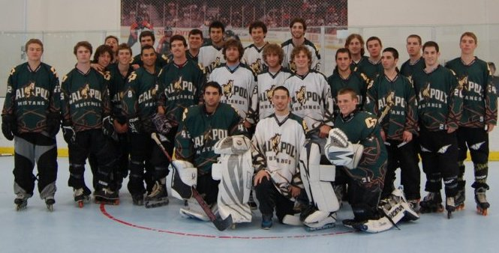
We joined clubs, offices and teams

Slide 21
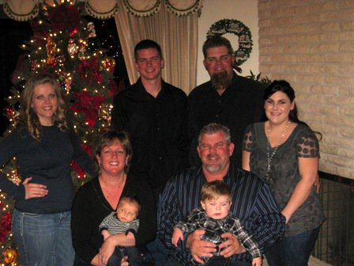
Getting involved to make our parents beam

Slide 22
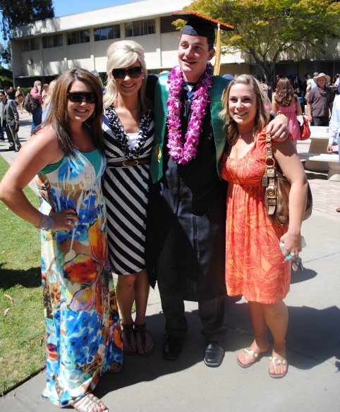
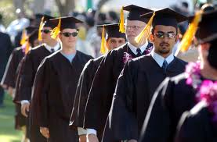
As graduation day comes to us near

Slide 23

Jobs and real life begins to appear

Slide 24
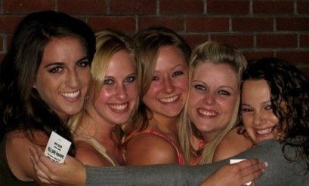
But as we look back on these fond days of college

Slide 25
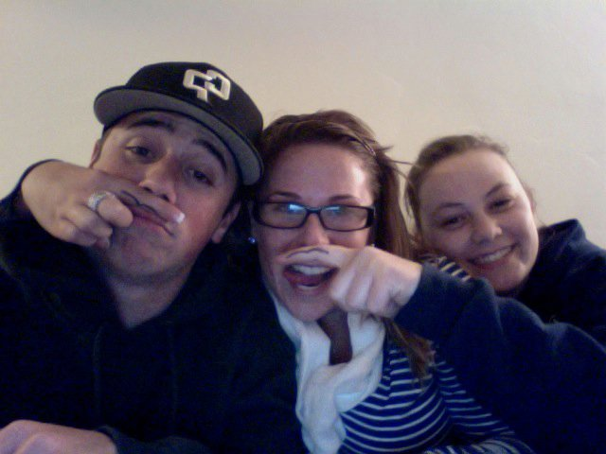
And even some useful and some meaning less knowledge

Slide 26
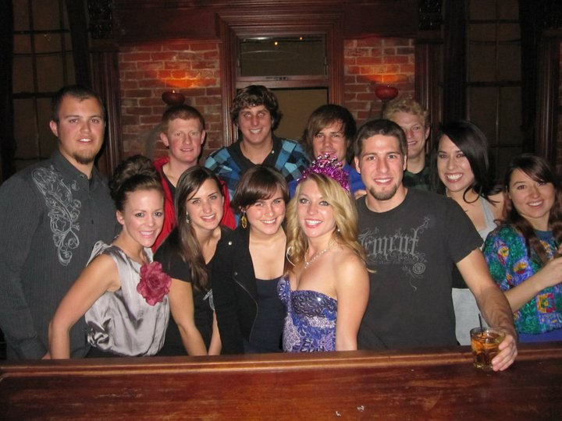
And even though its nice to get paid

Slide 27
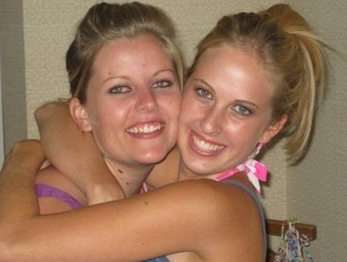
We will never forget the friends we have made

Slide 28

And in future days, we hope to come back

Slide 29
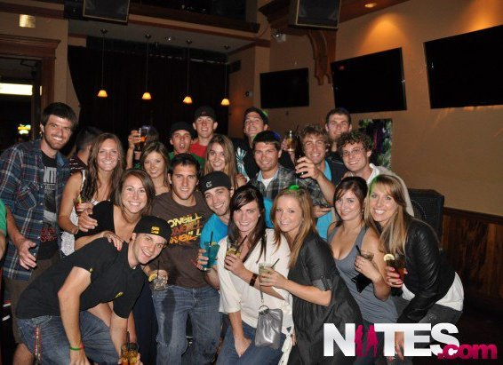
But memories will never be something we lack

Slide 30


